Slide 1


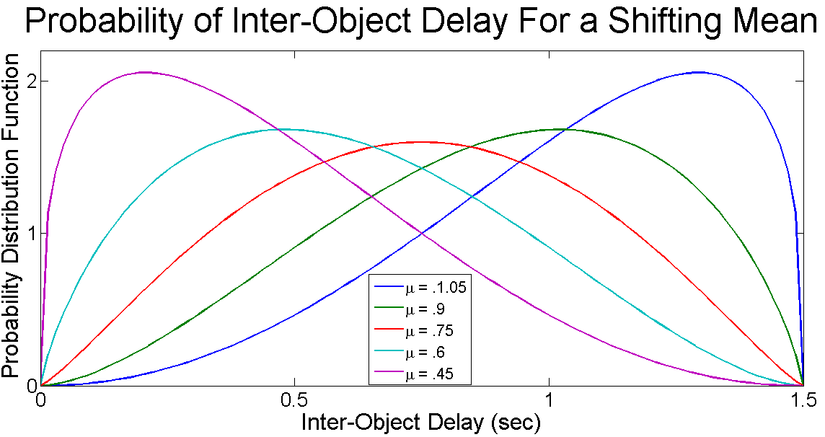
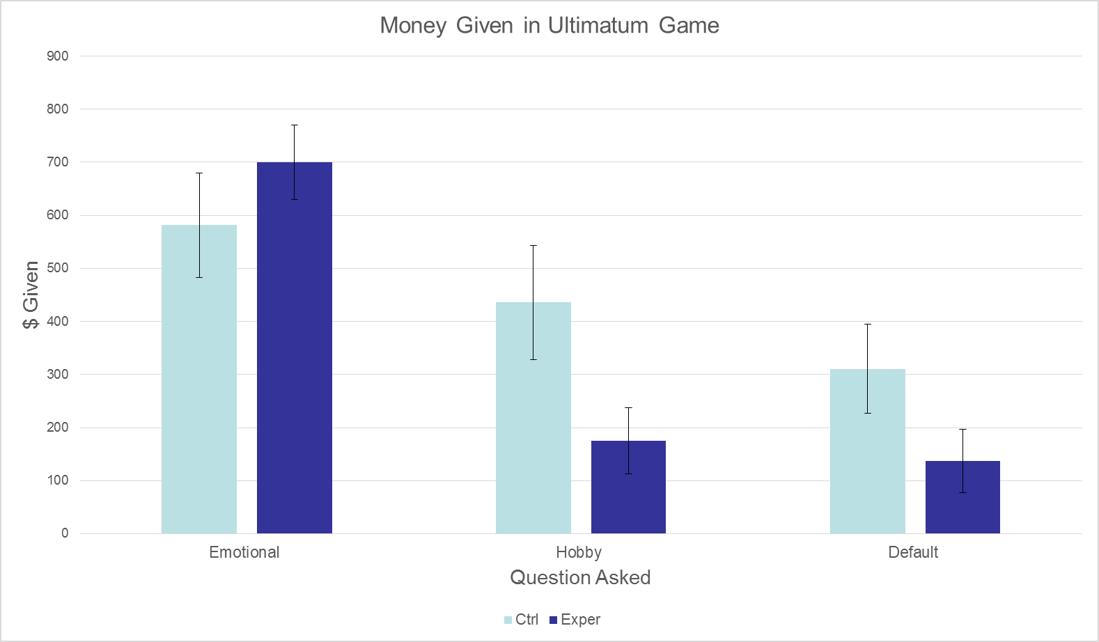

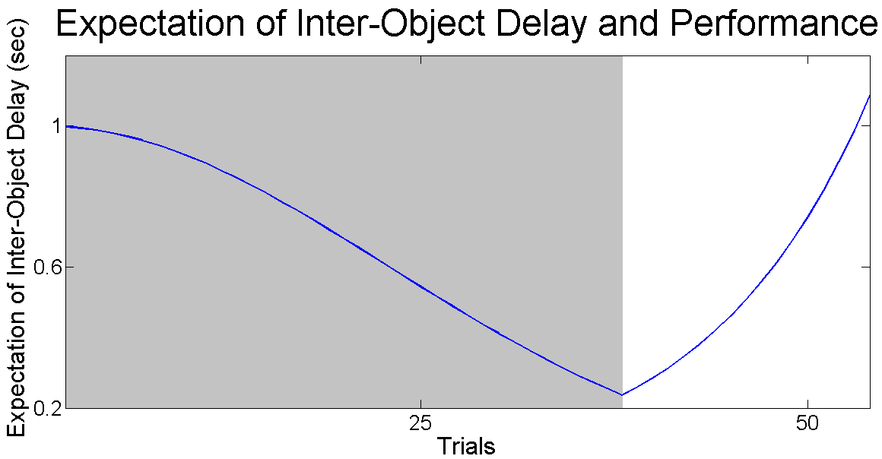
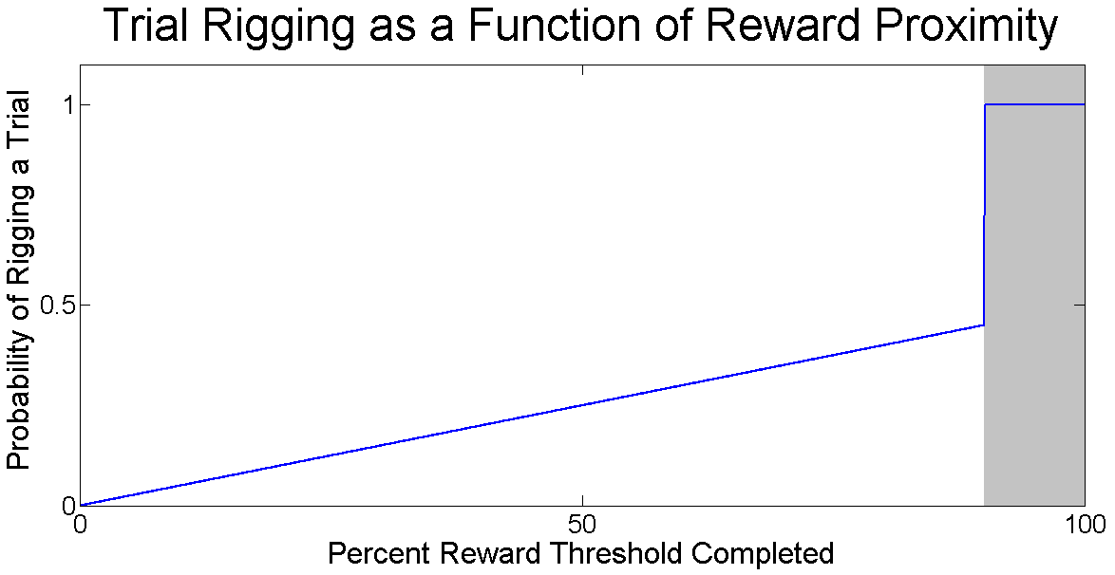
Factors Eliciting Changes in Generosity During the Ultimatum Game
Sydney Ellis, Charles Anumonwo, and Jack Terwilliger
Department of Psychological and Brain Sciences, Dartmouth College, USA
Method
Results
Research Question: What effect does frustration/stress have on interpersonal generosity?
Our study hopes to induce an emotional change (frustration) and use it as a predictor for a change in an ultimatum game outcome.
Hypothesis: Frustration will change the subjects’ levels of generosity as compared to the control groups’. Specifically, being in a frustrated state will decrease generosity.
Randomly generated timing delays
Generative model changes with
performance
*
Poor performance lengthens
average delay
In the exp. condition, good
performance shortens average
delay(grey)
PARTICPANTS:
16 Psych 11 students participating for course credit. Mean age was 21.44, std dev of 3.03, std error of .76
Randomly assigned to 2groups, 8 in control condition, 8 in experimental condition.
MATERIALS/DESIGN:
4, 21.5 inch screen iMac desktop computers running a conditioning task implemented in a MATLAB script, a paper questionnaire, candy bars.
Independent Variable: frustration task the participant carries out before the ultimatum games.
Dependent Variable: the relative difference in money divided between the participant and the hypothetical character in each of the three ultimatum games.
PROECDURE:
Statistical Analysis verifies that:
For effect of Question Asked (Emotional, Hobby, Default) on $ Given: F(2,16) = 18.01, p = .000
For effect of Frustration Condition (Control vs. Frustrated) on $ Given: F(1,16) = 1.75, p = .207
For effect of interaction between Frustration Condition and Question Asked: F(2,16) = 3.65, p = .039
Post Hoc T-tests indicate that:
Emotional Question had significant effect on $ Given when compared to Hobby Question and Default Question
T(15)=5.06, p =.000, T(15)=3.70, p = .002
Effect of Frustration condition was significant when answering Hobby Question T(14) – 2.10, p=.05
In exp. condition, tasks are
rigged against the participants
with a given rate.
The rate increases as participants
get closer to the reward threshold.
Step 1: Signal which box appears first. Hit “F” for left and “J” for right.
Method
Discussion/Conclusions
Control
Experimental
PROGRESS
PROGRESS
Step 2. Ultimatum Game
People who are frustrated are less generous with other individuals
This effect is reversed when dealing with an emotional situation
This may be an example of cognitive hypercorrection (See Gil-White)
Default Question:
You are given an envelope with 1000 dollars inside. Your task is to come up with a division of the money between you and 1 other person. While you will not meet the other person, you can keep as much of the money as you want and the remainder will be given to other individual.
Neutral Incentive Question:
John builds model ships in his spare time and is saving up to purchase a new
component. He will likely put whatever money you give him towards this hobby.
You have also been saving up for your own hobby and would likely use the money towards it.
Emotional Incentive Question:
Your good friend Michael was in a bad car accident, and will be unable to pay the medical bill for the care he desperately needs. However, you are in great need of this money to pay your next month’s rent to avoid your pending eviction.
How much money would leave for the next person?
I would leave __________ Dollars
References
PROGRESS
PROGRESS
Yu, R., Mobbs, D., Seymour, B., Rowe, J. B., & Calder, A. J. (2014). The neural signature
of escalating frustration in humans. Cortex, 54, 165-178.
Gray, K., Ward, A. F., & Norton, M. I. (2014). Paying it forward: Generalized reciprocity
and the limits of generosity. Journal of Experimental Psychology: General, 143(1), 247.
Sanfey, A. G., Rilling, J. K., Aronson, J. A., Nystrom, L. E., & Cohen, J. D. (2003).
The neural basis of economic decision-making in the ultimatum game.
Science, 300(5626), 1755-1758.
Thaler, R. H. (1988). Anomalies: The ultimatum game. The Journal of Economic
Perspectives, 195-206.
Time = 1 sec
Response: “F”
Time = .25 sec
Response: “J”
Contact: jack.f.terwilliger@gmail.com, canumonwo@gmail.com, Sydney.W.Ellis.15@dartmouth.edu

